Slide 1
Lecture-5
The Kinetic Theory of Gases
AVOGADRO’S NUMBER:
One mole of a substance contains 6.023 x 10²³ elementary units of atoms or molecules.
This number is called Avogadro Numbers, N_{A}.
So, the total number of atoms or molecules in n mole substance, N= N = nN_{A}
Molar Mass: Molar mass M of any substance is the mass of one mole of the substance.
If m is the mass of one atom then the molar mass, M = mN_{A}

Slide 2
The ideal gas law
Boyle’s Law : P∝1/V ----------------------------------(1)
Charles's Law : V∝T------------------------------------------(2)
By combining two equations and the fact that V ∝ n, we can write the ideal gas equation as,
PV=nRT [R in terms of mole]
Or, PV=NkT [k in terms of molecule]
Where the Boltzmann constant, k = R/N_{A}

Slide 3

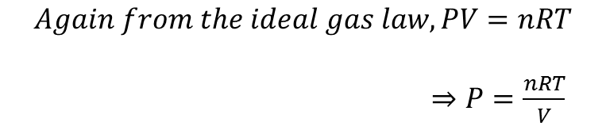

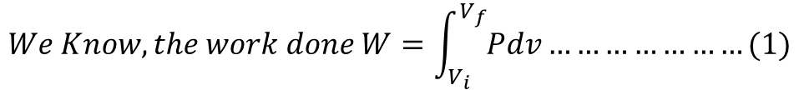

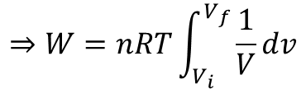
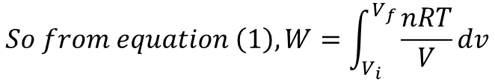
Work Done by Gas in Isothermal Process
$$We Know, the work done W=\int_{V_{i}}^{V_{f}}{Pdv}…………………(1)$$
$$Again from the ideal gas law, PV=nRT$$
$⇒P=\frac{nRT}{V}$
$$⇒W=nRT {[lnV]}_{V_{i}}^{V_{f}}$$
$$So from equation \left(1\right),W=\int_{V_{i}}^{V_{f}}{\frac{nRT}{V}dv}$$
$$⇒W=nRT[lnV_{f}−lnV_{i}]$$
$$⇒W=nRT\int_{V_{i}}^{V_{f}}{\frac{1}{V}dv}$$
$$∴W=nRT ln\frac{V_{f}}{V_{i}}$$

Slide 4





Work Done at Constant Volume and at Constant Pressure
If the volume of the gas is constant, then
$$W=\int_{V_{i}}^{V_{f}}{Pdv}$$
If the pressure is constant then the work done,
$$⇒W=P {[V]}_{V_{i}}^{V_{f}}$$
$$⇒W=P[V_{f}−V_{i}]$$
$∴W=P∆V$ (Constant Pressure)

Slide 5
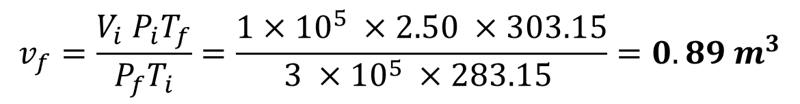
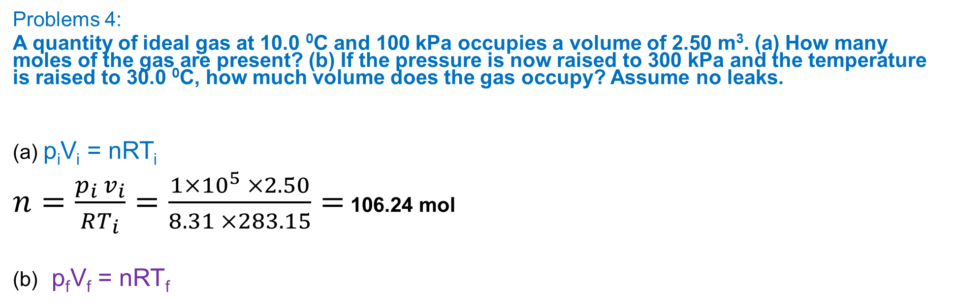
Problems 4:
A quantity of ideal gas at 10.0 ⁰C and 100 kPa occupies a volume of 2.50 m³. (a) How many moles of the gas are present? (b) If the pressure is now raised to 300 kPa and the temperature is raised to 30.0 ⁰C, how much volume does the gas occupy? Assume no leaks.
(a) p_{i}V_{i} = nRT_{i}
$n=\frac{p_{i} v_{i}}{RT_{i}}=\frac{1×{10}^{5} ×2.50}{8.31 ×283.15}=$ 106.24 mol
(b) p_{f}V_{f} = nRT_{f}
$$v_{f}=\frac{V_{i} P_{i}T_{f}}{P_{f}T_{i}}=\frac{1×{10}^{5} ×2.50 ×303.15}{3 ×{10}^{5} ×283.15 }=0.89 m^{3}$$

Slide 6
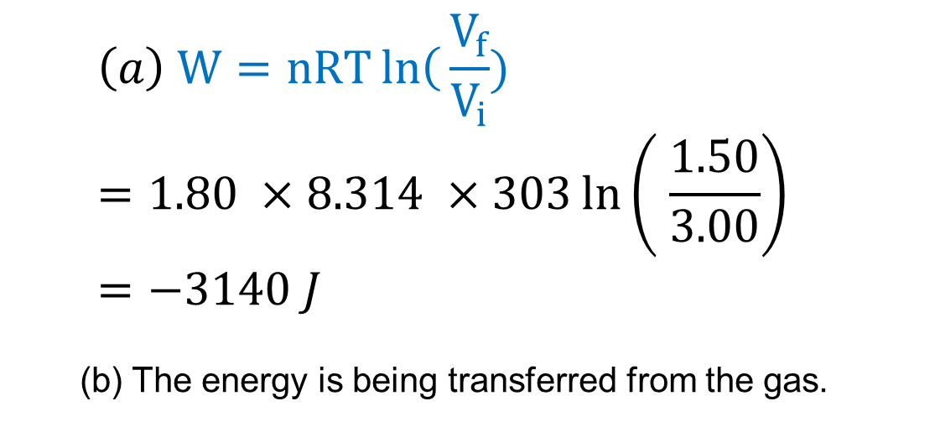
Problem 7: Suppose 1.80 mol of an ideal gas is taken from a volume of 3.00 m³ to a volume of 1.50 m³ via an isothermal compression at 30 ⁰C. (a) How much energy is transferred as heat during the compression, and (b) is the transfer to or from the gas?
$$\left(a\right) W=nRT\left.ln\right({\frac{V_{f}}{V_{i}}}) =1.80 ×8.314 ×303\ln\left( \frac{1.50}{3.00}\right) =−3140 J$$
(b) The energy is being transferred from the gas.

